Slide 1


Slide 2
Contents
Pipe Flow and Open Channel Flow
Classification

Slide 3
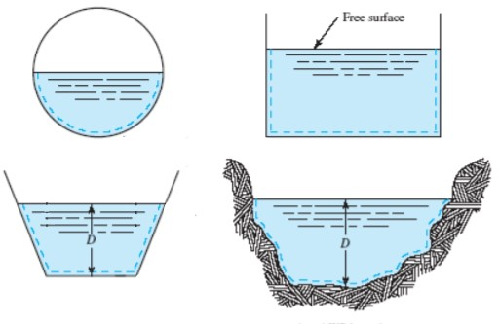
Open channel flow – introduction
The flow in an open channel or in a closed conduit having a free surface is referred to as free-surface flow or open-channel flow.

Slide 4
Open channel flow – introduction
Open Channel Hydraulics is of great importance to Civil Engineers as it deals with
  Channels constructed for Water Supply, Irrigation, Drainage
  Sewers, Culverts
  Tunnels flowing Partially Full
  Natural Streams and Rivers.

Slide 5
PIPE FLOW & Open channel flow – Comparison
PIPE FLOW | OPEN CHANNEL FLOW
The liquid completely fills the pipe and flow under pressure. | The flow must be classified as open channel flow if the liquid has a free surface
The flow in a pipe takes place due to difference of pressure (pressure gradient), | Flow takes place due to the slope of the channel bed (due to gravity)
The flow in a closed conduit is not necessarily a pipe flow

Slide 6
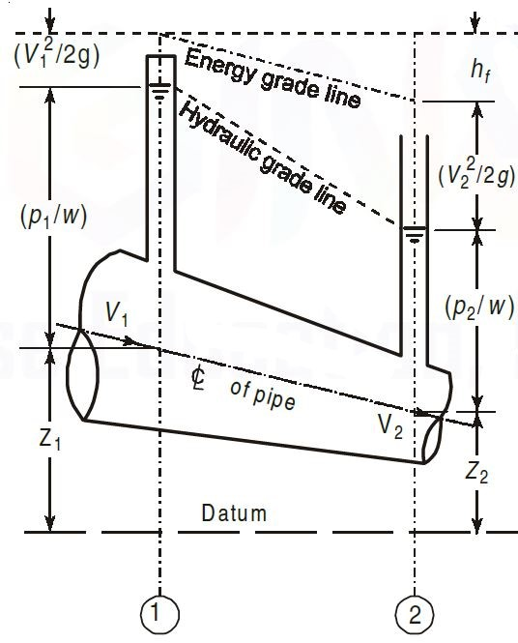
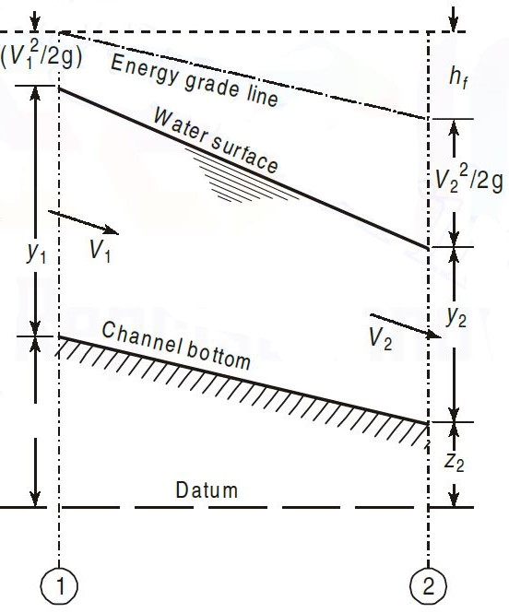
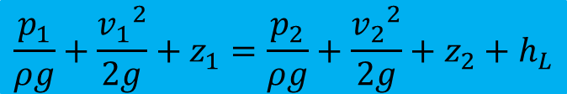
PIPE FLOW & Open channel flow – Comparison
$$\frac{p_{1}}{ρg}+\frac{{v_{1}}^{2}}{2g}+z_{1}=\frac{p_{2}}{ρg}+\frac{{v_{2}}^{2}}{2g}+z_{2}+h_{L}$$

Slide 7
PIPE FLOW & Open channel flow – Comparison
PIPE FLOW
  The Hydraulic Gradient Line (HGL) is the sum of the Elevation and the Pressure Head (connecting the water surfaces in piezometers).
  The Energy Gradient Line (EGL) is the sum of the HGL and Velocity Head.
  The amount of Energy Loss when the liquid flows from section 1 to section 2 is indicated by h_{L}.
OPEN CHANNEL FLOW
  The Hydraulic Gradient Line (HGL) corresponds to the Water Surface Line (WSL); where it subjected to only Atmospheric Pressure which is commonly referred to as the Zero Pressure Reference.
  The Energy Gradient Line (EGL) is the sum of the HGL and Velocity Head.
  The amount of Energy Loss when the liquid flows from section 1 to section 2 is indicated by h_{L}.
  For uniform flow, the drop in the EGL is equal to the drop in the channel bed.

Slide 8
PIPE FLOW & Open channel flow – Comparison

Slide 9
Open channels – Classification
Based on Existence
  Natural Channels
    Streams, Rivers, Valleys, etc.
    These are generally irregular in shape, alignment and roughness of the surface.
  Artificial Channels
    built for some specific purpose, such as irrigation, water supply, wastewater, water power development, and rain collection channels.
    These are regular in shape and alignment with uniform roughness of the boundary surface.
    Irrigation channels are often built with trapezoidal cross-section. Sewage channels are mostly made with circular cross-section.

Slide 10
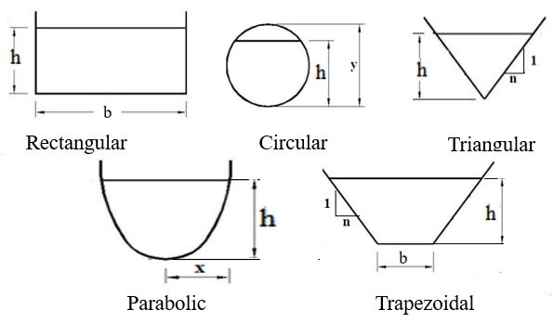
Open channels – Classification
Based on Shape
  Prismatic Channels
    Cross-Section is Uniform
    Bed Slope is Constant.
  Non-Prismatic Channels
    Either the Cross-Section or the Slope (or Both) Change
    It is obvious that only Artificial Channel can be Prismatic

Slide 11
Types of flow
Steady and Unsteady Flows
Uniform and Non-Uniform Flows
Laminar and Turbulent Flows
Compressible and Incompressible Flows
Rotational and Irrotational Flows
One, Two and Three Dimensional Flows

Slide 12
Open channel Flows – Classification
Based on Time Criterion
  Steady Flow (Time Independent)
    Discharge and Water Depth do not change with Time
  Unsteady Flow (Time Dependent)
    Discharge and Water Depth at any section change with Time

Slide 13
Steady and Unsteady Flows
Steady:
Flow in which Conditions of Flow remains Constant w.r.t. Time at a particular section or point.
Flow conditions: Velocity, Pressure, Density or Cross-sectional Area etc.
$${\left(\frac{∂V}{∂t}\right)}_{x_{0},y_{0},z_{0}}=0$$
$${\left(\frac{∂p}{∂t}\right)}_{x_{0},y_{0},z_{0}}=0$$
$${\left(\frac{∂ρ}{∂t}\right)}_{x_{0},y_{0},z_{0}}=0$$

Slide 14
Steady and Unsteady Flows
Unsteady:
Flow in which Conditions of Flow Changes w.r.t. Time at a particular section or point.
Flow conditions: Velocity, Pressure, Density or Cross-sectional Area etc.
$${\left(\frac{∂V}{∂t}\right)}_{x_{0},y_{0},z_{0}}≠0$$
$${\left(\frac{∂p}{∂t}\right)}_{x_{0},y_{0},z_{0}}≠0$$

Slide 15
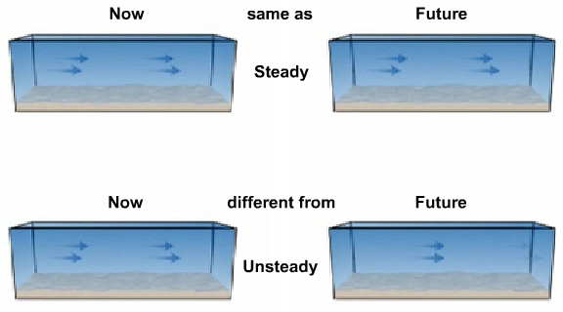
Steady and Unsteady Flows

Slide 16
Open channel Flows – Classification
Based on Space Criterion
  Uniform Flow
    Discharge and Water Depth remains the same at every section in the channel
  Non-Uniform Flow
    Discharge and Water Depth change at any section in the channel

Slide 17
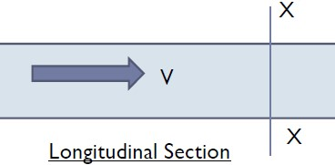
uniform and non-uniform Flows
Uniform:
Flow in which Conditions of Flow remains Constant from section to section at any given Time
Example: Constant Discharge though a Constant Diameter of Pipe
$${\left(\frac{∂V}{∂x}\right)}_{t=constant}=0$$

Slide 18
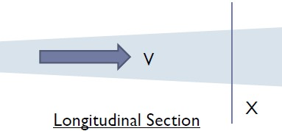
uniform and non-uniform Flows
Non-Uniform:
Flow in which Conditions of Flow Changes from section to section at any given Time
Example: Constant Discharge though a Variable Diameter of Pipe
$${\left(\frac{∂V}{∂x}\right)}_{t=constant}≠0$$

Slide 19
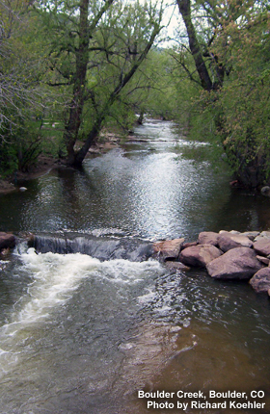
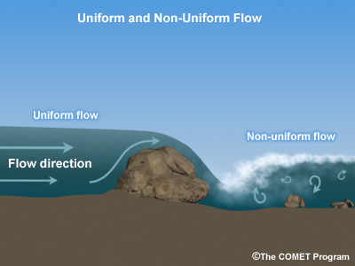
uniform and non-uniform Flows

Slide 20
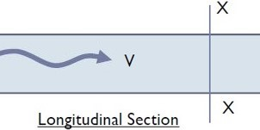
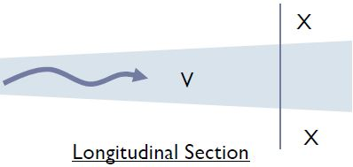
Flow combinations
$$Q_{Constant}$$
Steady Uniform
Steady Non-Uniform
Unsteady Non-Uniform
$$Q_{Constant}$$
$$Q_{Variable}$$
$$Q_{Variable}$$

Slide 21
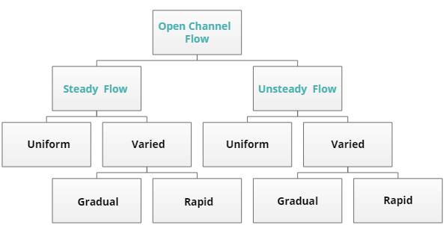
Open channel Flows – Classification

Slide 22
Open channels – Classification
Based on Existence
  Natural Channels
  Artificial Channels
Based on Shape
  Prismatic Channels
  Non-Prismatic Channels

Slide 23
Open channel Flows – Classification
Based on Time Criterion
  Steady Flow
  Unsteady Flow
Based on Space Criterion
  Uniform Flow
  Non-Uniform Flow

Slide 24
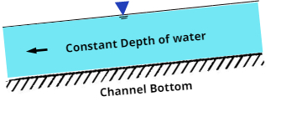
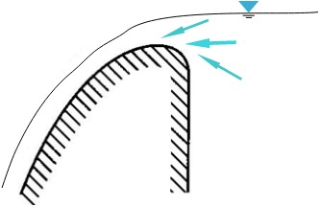
Flow combinations
Steady Uniform
Uniform flows are mostly steady
Steady Non-Uniform
Over a Spillway Crest

Slide 25
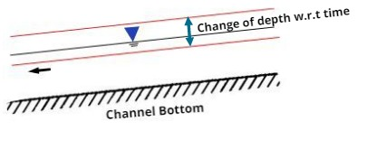
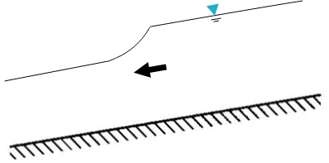
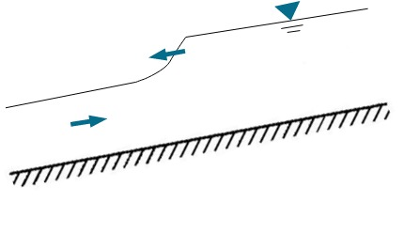
Flow combinations
Unsteady Uniform
Unsteady uniform flows are very rare in nature
Unsteady Non-Uniform
Flood Wave
Tidal Surge

Slide 26
Non-Uniform flow
Non-Uniform Flow is also called Varied Flow
Flow in which the Water Depth and/or Discharge change along the length of the channel
It can be further classified as
  Gradually Varied Flow (GVF) where the depth of the flow changes gradually along the length of the channel
  Rapidly Varied Flow (RVF) where the depth of flow changes suddenly over a small length of the channel

Slide 27
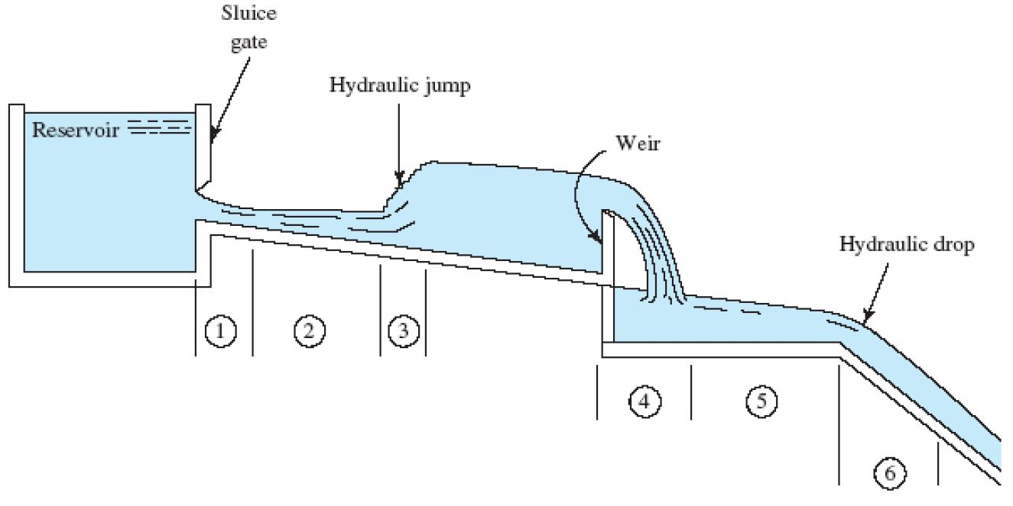
Non-uniform or varied flow

Slide 28
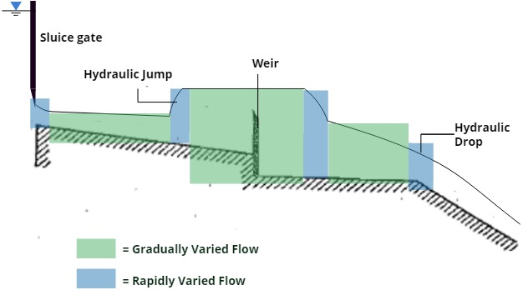
Flow combinations

Slide 29
FORCES and dimensionless numbers
  Inertia Force, F_{i}
  Viscous Force, F_{ν}
  Gravity Force, F_{g}
  Pressure Force, F_{p}
  Surface Tension Force, F_{s}
  Elastic Force, F_{e}
  Reynold’s Number, R_{e}
  Froude’s Number, F_{r}
  Euler’s Number, E_{u}
  Weber’s Number, W_{e}
  Mach’s Number, M

Slide 30
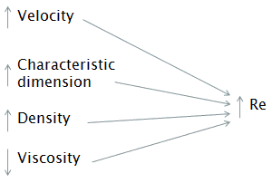
Laminar and Turbulent Flows – Reynolds Number
Reynolds Number (Re):
Reynolds number is used to differentiate between laminar and turbulent flows
$$Re=\frac{Inertia Force}{Viscous Force}=\frac{VD}{θ}=\frac{ρVD}{μ}$$

Slide 31
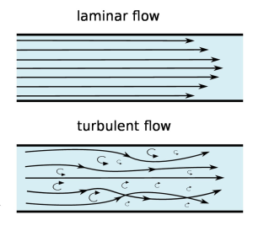
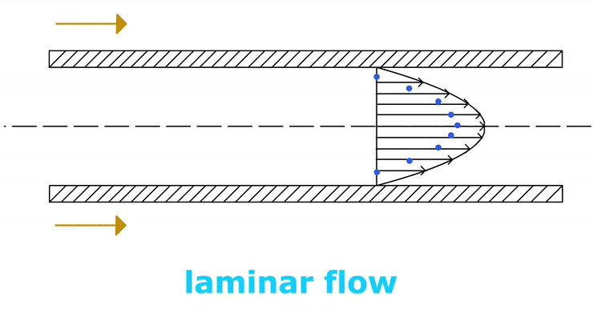
Laminar and Turbulent Flows
Laminar:
The fluid flow in laminations (layers) is termed as laminar flow

Slide 32
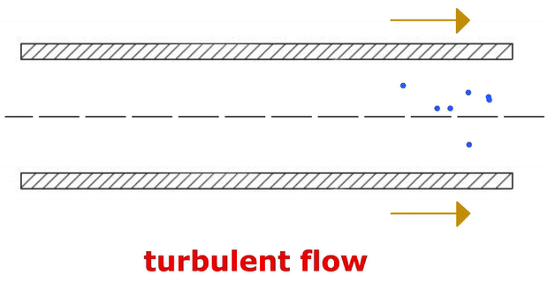
Laminar and Turbulent Flows
Turbulent:
The fluid flow layers intermix with each other is termed as turbulent flow
Highly disordered fluid motion that typically occurs at higher velocities and is characterized by velocity fluctuations

Slide 33

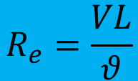


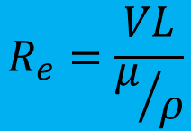

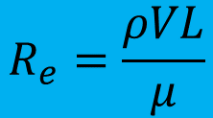

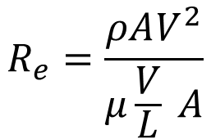

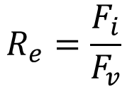
Reynold’s Number, R_{e}
It is defined as the ratio of inertia force of a flowing fluid and the viscous force of the fluid.
$$F_{i}=ρAV^{2}$$
$$F_{v}=μ\frac{V}{L} A$$
$$R_{e}=\frac{F_{i}}{F_{v}}$$
$$F_{g}=ρALg$$
$$R_{e}=\frac{ρAV^{2}}{μ\frac{V}{L} A}$$
$$F_{p}=pA$$
$$R_{e}=\frac{ρVL}{μ}$$
$$F_{s}=σL$$
$$R_{e}=\frac{VL}{μ/ρ}$$
$$R_{e}=\frac{VL}{θ}$$
$$F_{e}=KA$$

Slide 34
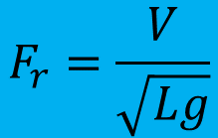
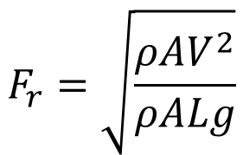
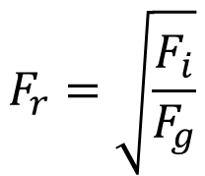
Froude’s Number, F_{e}
It is defined as the square root of the ratio of inertia force of a flowing fluid to the gravity force.
$$F_{i}=ρAV^{2}$$
$$F_{v}=μ\frac{V}{L} A$$
$$F_{r}=\sqrt{\frac{F_{i}}{F_{g}}}$$
$$F_{g}=ρALg$$
$$F_{r}=\sqrt{\frac{ρAV^{2}}{ρALg}}$$
$$F_{p}=pA$$
$$F_{s}=σL$$
$$F_{r}=\frac{V}{\sqrt{Lg}}$$
$$F_{e}=KA$$

Slide 35
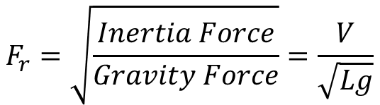
Critical; Sub-critical; super-critical Flows
– FROUDE Number
Froude Number (Fr):
Froude number is used to differentiate between Critical; Sub-Critical and Super-Critical Flows
$$F_{r}=\sqrt{\frac{Inertia Force}{Gravity Force}}=\frac{V}{\sqrt{Lg}}$$

Slide 36
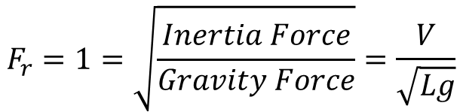
Critical Flows
A flow is called Critical if the flow velocity is equal to the velocity of a gravity wave having small amplitude
$$F_{r}=1=\sqrt{\frac{Inertia Force}{Gravity Force}}=\frac{V}{\sqrt{Lg}}$$

Slide 37
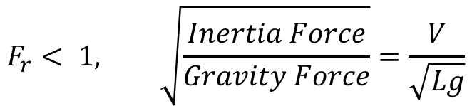
Sub-Critical Flows
A gravity wave may be produced by a change in the flow depth.
The flow is called Sub-Critical flow, if the Flow Velocity is less than the Critical Velocity
Sub-Critical flow is also called Tranquil or Streaming flow
$$F_{r}< 1, \sqrt{\frac{Inertia Force}{Gravity Force}}=\frac{V}{\sqrt{Lg}}$$

Slide 38
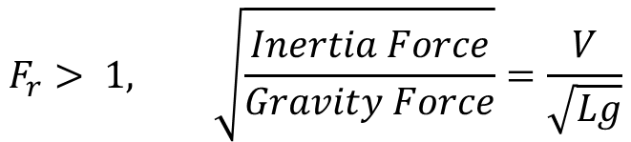
Super-Critical Flows
The flow is called Super-Critical flow, if the Flow Velocity is greater than the Critical Velocity
$$F_{r}> 1, \sqrt{\frac{Inertia Force}{Gravity Force}}=\frac{V}{\sqrt{Lg}}$$

Slide 39
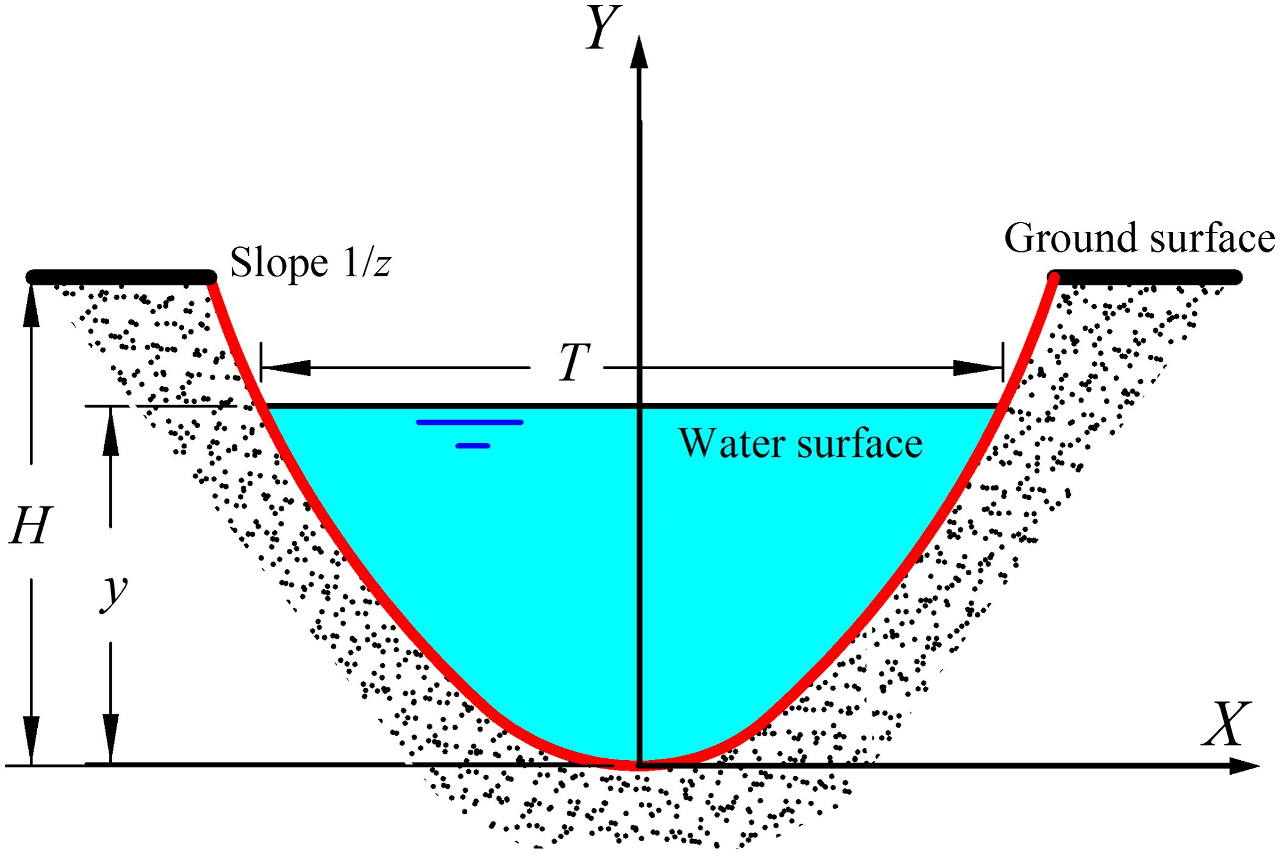
Geometric parameters of channel section

Slide 40
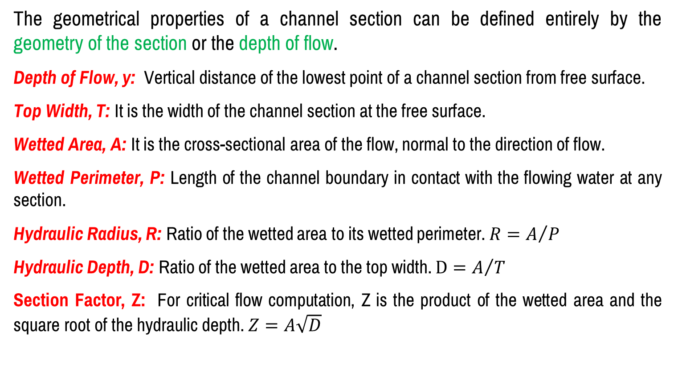
Geometric parameters of channel section
The geometrical properties of a channel section can be defined entirely by the geometry of the section or the depth of flow.
Depth of Flow, y: Vertical distance of the lowest point of a channel section from free surface.
Top Width, T: It is the width of the channel section at the free surface.
Wetted Area, A: It is the cross-sectional area of the flow, normal to the direction of flow.
Wetted Perimeter, P: Length of the channel boundary in contact with the flowing water at any section.
Hydraulic Radius, R: Ratio of the wetted area to its wetted perimeter. $R=A/P$
Hydraulic Depth, D: Ratio of the wetted area to the top width. $D=A/T$
Section Factor, Z: For critical flow computation, Z is the product of the wetted area and the square root of the hydraulic depth. $Z=A\sqrt{D}$

Slide 41
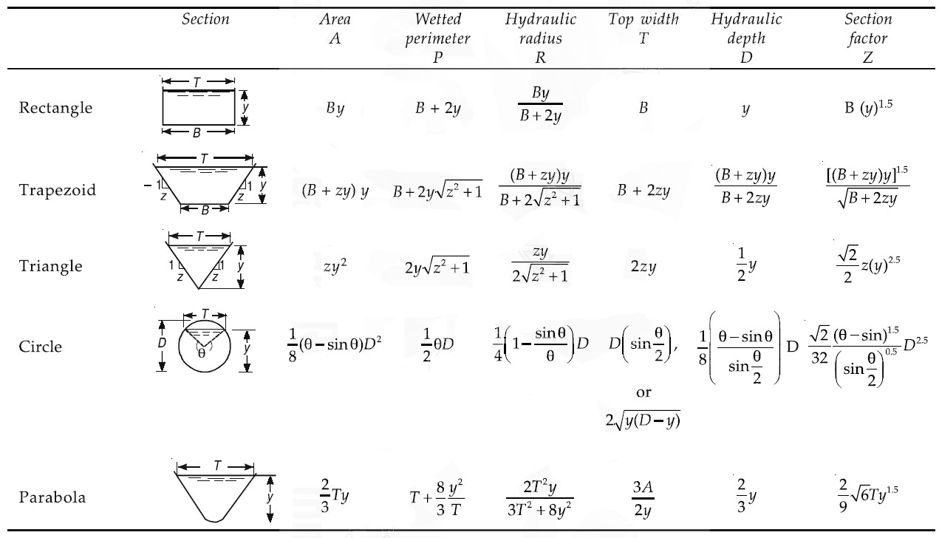
Geometric elements of channel section

Slide 42
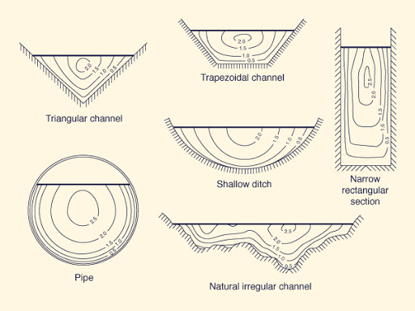
Velocity Distribution of channel section
The flow velocity in a channel section varies from one point to another. This is due to shear stress at the bottom and at the sides of the channel and due to the presence of free surface.

Slide 43
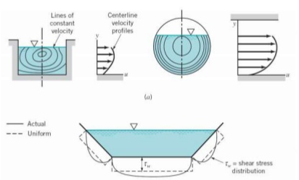
Velocity Distribution of channel section

Slide 44
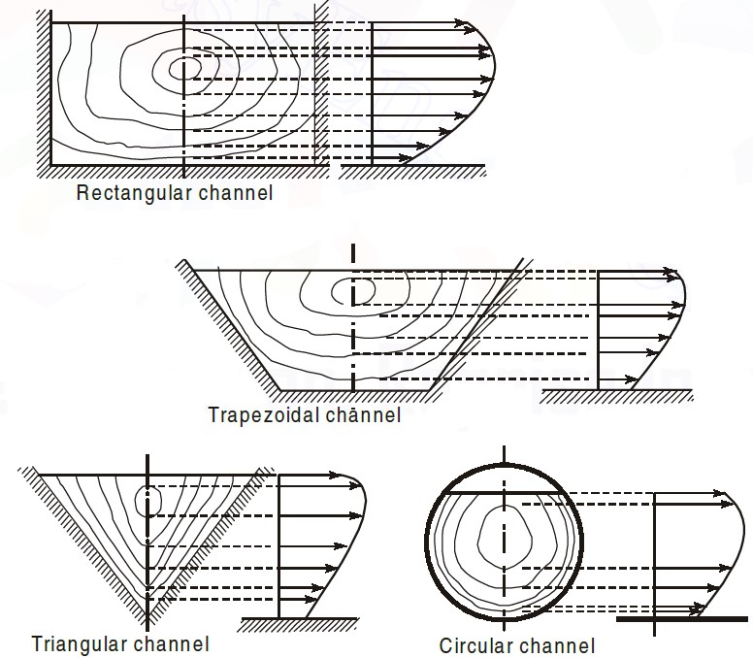
Velocity Distribution of channel section

Slide 45


